Slide 1
SCOPE IN JAVASCRIPT

Slide 2
What is a Scope?
It is a region of a program where a defined variable exists and can be recognized and beyond that region it cannot be recognized.
Types of Scope:
Global Scope: A variable declared outside any function or block that can be accessed from anywhere in the program.
Function Scope (Local Scope): A variable declared inside a function that can only be accessed within that function.
Block Scope: A variable declared inside a block { }.
What is a Variable?
A variable is a container that stores data so it can be used later in the program.

Slide 3
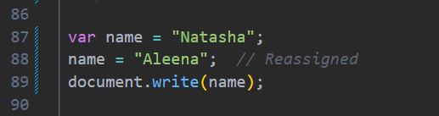
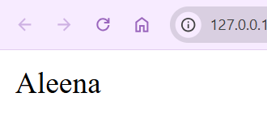
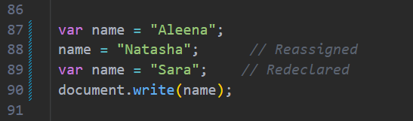
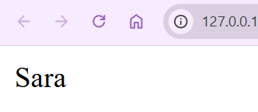
Types of Scope:
var
let
const
1. var
var is the old way of declaring a variable where the value can be changed, and the variable can also be declared again.

Slide 4
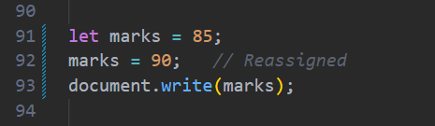
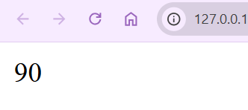
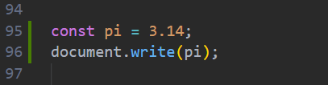
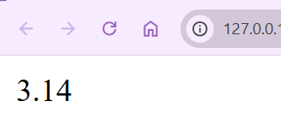
2. let
let was introduced in ES6 in 2015 is used to declare a variable whose value can be changed later, but it cannot be declared again in the same scope.
3. const
const was also introduced in ES6 in 2015 is used to declare a variable whose value cannot be changed after it is assigned.

Slide 5
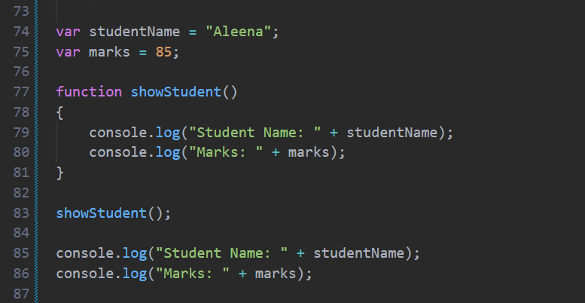
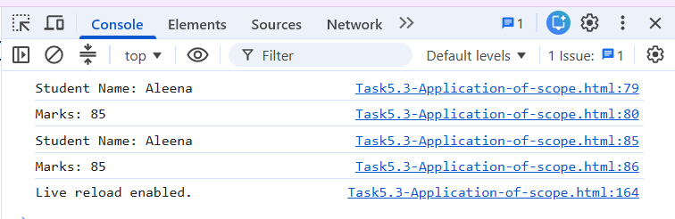
Scope Application in Var
Global Scope
As shown in the code above, when the variables are declared and initialized before the function using var, they are declared in the global scope. This means they can be accessed anywhere in the program. Whether they are called inside the function or outside the function, they will print the required output successfully because global variables are accessible throughout the program.

Slide 6
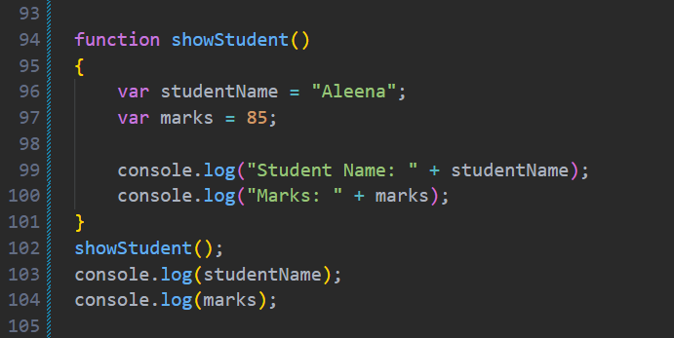
2. Functional Scope
As shown in the code above, the variables studentName and marks are declared inside the showStudent() function using var. When the function is called, both variables are printed successfully because they are being accessed within the same function. However, when we try to print studentName and marks outside the function, JavaScript throws a ReferenceError.

Slide 7
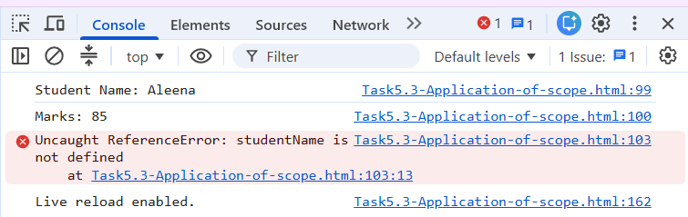
From this behavior, we can identify that var follows function scope, meaning variables declared inside a function can only be accessed within that function. Additionally, JavaScript executes the code line by line, so when it encounters the error at studentName, the program stops immediately and the marks statement is not execute

Slide 8
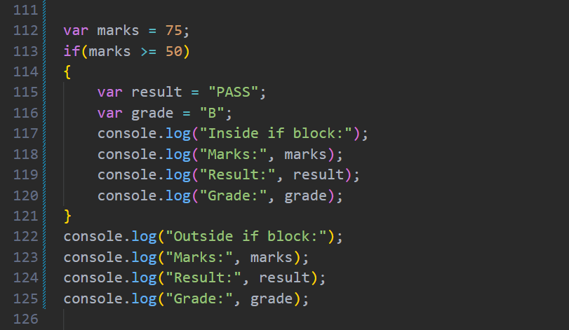
3. Block scope
As shown in the code above, the variables result and grade are declared inside the if block using var.

Slide 9
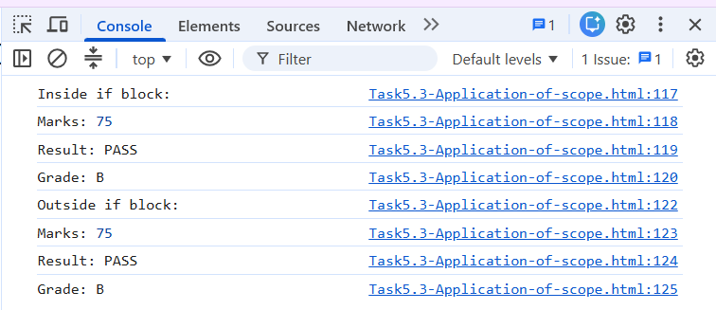
When the code is executed, they are printed successfully inside the block. They are also printed successfully outside the if block because var does not follow block scope. From this behavior, we can identify that variables declared with var inside an if block remain accessible outside the block. Therefore, marks, result, and grade can all be accessed and printed successfully without any error.

Slide 10
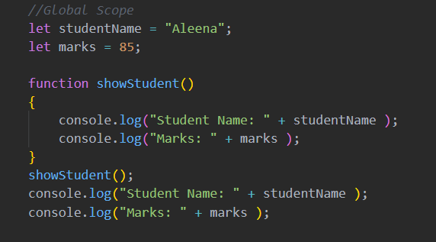
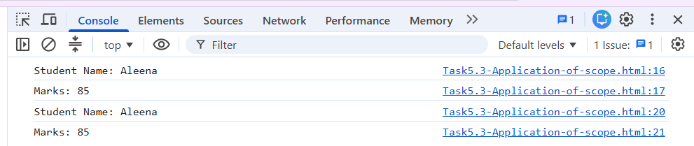
Scope Application in let
Global Scope
As it is shown the code on the left that when the variable is declared and initializes before the function means globally it has been declare and can be used as many times as we can. Whether it is called in the function or outside the function it will still print the text we required.

Slide 11
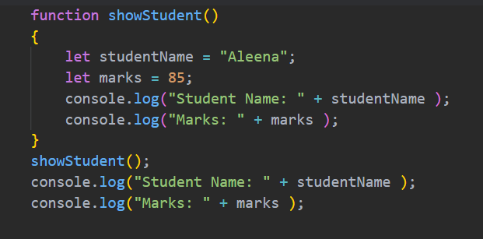
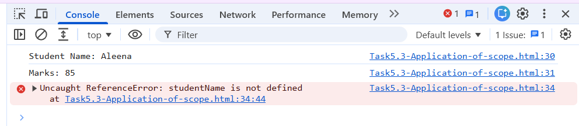
2. Functional Scope
As shown in the code, when the variable is declared inside the function via ‘let’ and is called afterwards it will print the text inside it. But if we tried to print the text outside the function it will give us error that the variable you are trying to print is undefined. This shows that the let has a functional scope.

Slide 12
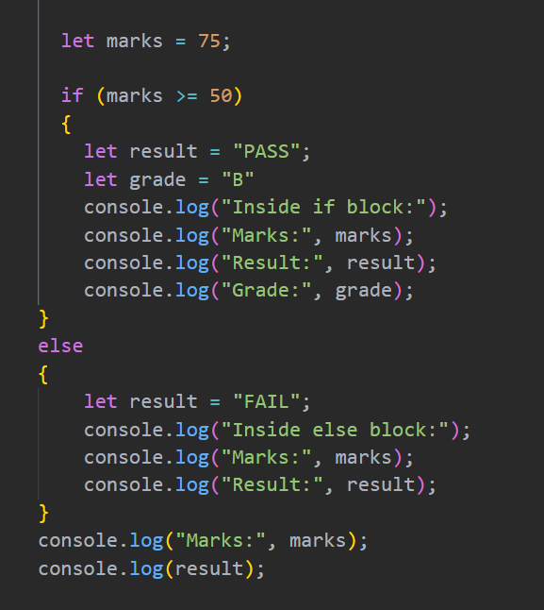
3. Block Scope
As shown in the code, when the variables result and grade are declared inside the if else block using let, they can only be accessed within that block. Therefore, they are printed successfully inside the block. However, when we try to print the result variable outside the if else block, JavaScript gives a ReferenceError: result is not defined. This shows that a variable declared inside { } can only be accessed within that block. The marks variable is printed successfully outside the block because it was declared outside the if else statement, making it accessible throughout the program.

Slide 13
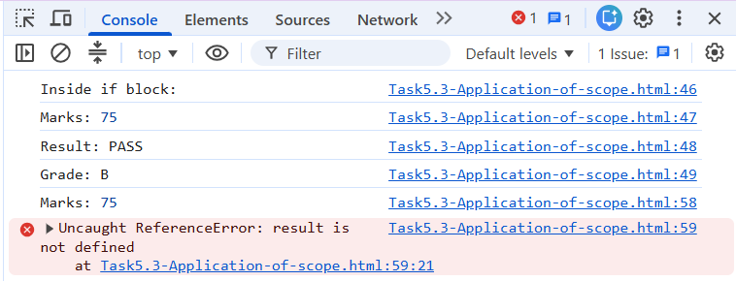
Furthermore, if we move all the console.log() statements outside the if else block and then run the code. The marks variable will print successfully because it was declared outside the block and is accessible throughout the program but it stops execution at the result variable because JavaScript follows a synchronous execution order.

Slide 14
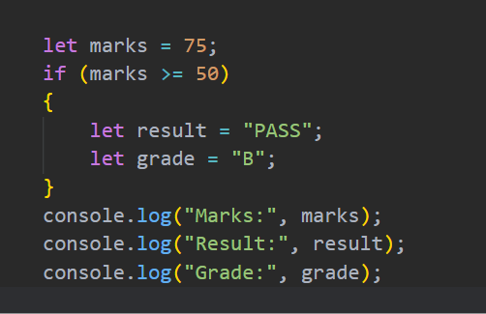
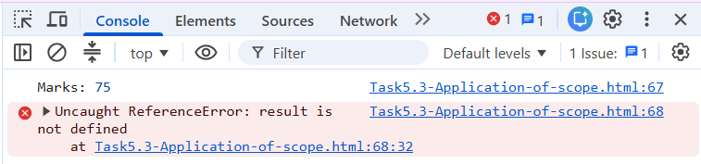
It runs the code line by line, and when it encounters an error at result, the program stops immediately, so the remaining statements are not executed.

Slide 15
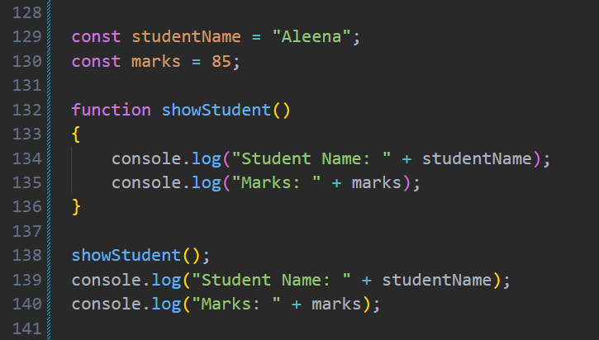
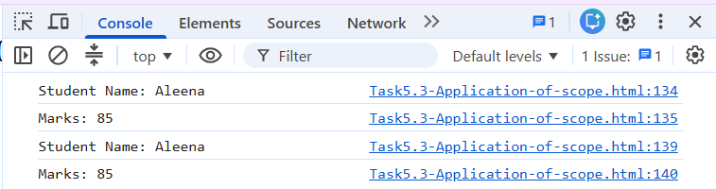
Scope Application in const
Global Scope
The variables studentName and marks are declared and initialized before the function using const. When we execute the code, both variables are printed successfully inside the showStudent() function as well as outside the function. From this behavior, we identify that variables declared with const outside any function have global scope and can be accessed throughout the program. However, const variables cannot be reassigned after their declaration.

Slide 16
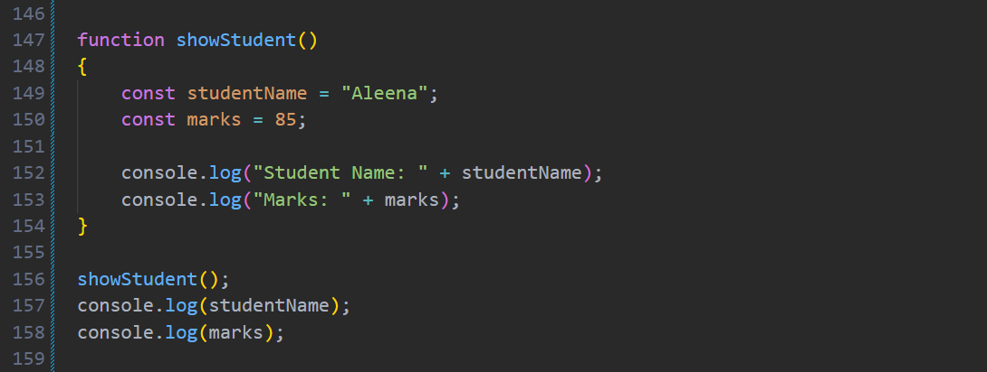
2. Functional Scope
As shown in the code above, the variables studentName and marks are declared inside the showStudent() function using const. When we execute the code, both variables are printed successfully inside the function because they are accessed within the same function where they are declared. However, when we try to print them outside the function, JavaScript gives a ReferenceError.

Slide 17
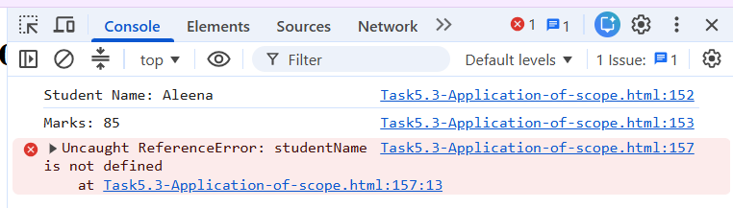
From this behavior, we identify that const follows function scope when declared inside a function, meaning these variables can only be accessed within that function. Additionally, JavaScript executes code line by line, so when it encounters the error at studentName, the program stops immediately and the marks statement is not executed.

Slide 18
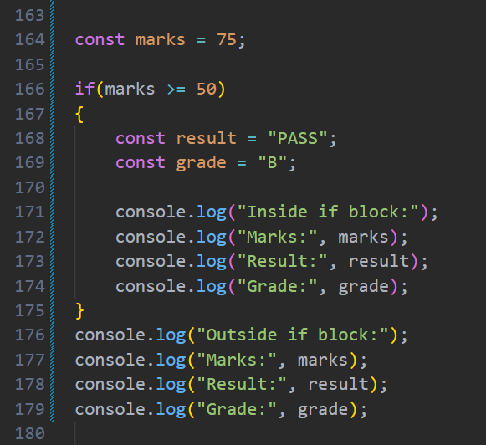
3. Block Scope
As shown in the code, the variables result and grade are declared inside the if block using const. When we execute the code, they are printed successfully inside the block. However, when we try to access them outside the block, JavaScript gives a ReferenceError.

Slide 19
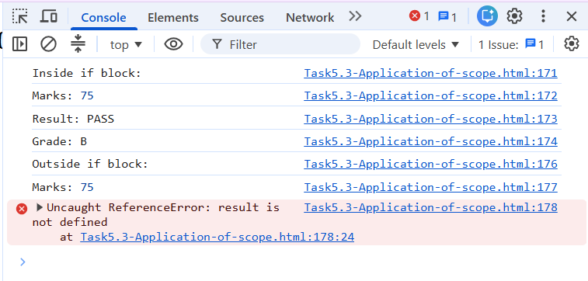
From this behavior, we identify that const follows block scope, meaning variables declared inside { } can only be accessed within that block. The marks variable is printed successfully outside the block because it was declared outside the if statement and is accessible throughout the program

Slide 20
Thank You

